Slide 1
Machine Learning
What is it? How is it different?

Slide 2
Confusing terminologies
Artificial Intelligence
Business Intelligence
Data Science
Data Analytics
Business Analytics
Data Mining

Slide 3
Let's start
Data
Business
Analysis refers to the process of segmenting your problem into easily digestible chunks that you can study individually and examine how they relate to each other.
Analytics is application of logical and computational reasoning to the component parts obtained in an analysis looking for patterns and often exploring what she can be done in the future.
Time: Past > Present > Future (predictive analytics).

Slide 4
Business Activities
Business case studies (Past)
Qualitative analytics (Present,Future)
Preliminary data report(ing) (Past)
Reporting with visuals (Past)
Creating dashboards (Past)
Sales forecasting (Future)

Slide 5
Artificial intelligence
Artificial intelligence (AI)is any form of intelligence shown by a machine, which resembles natural (human) intelligence such as planning, learning, problem solving, etc.

Slide 6
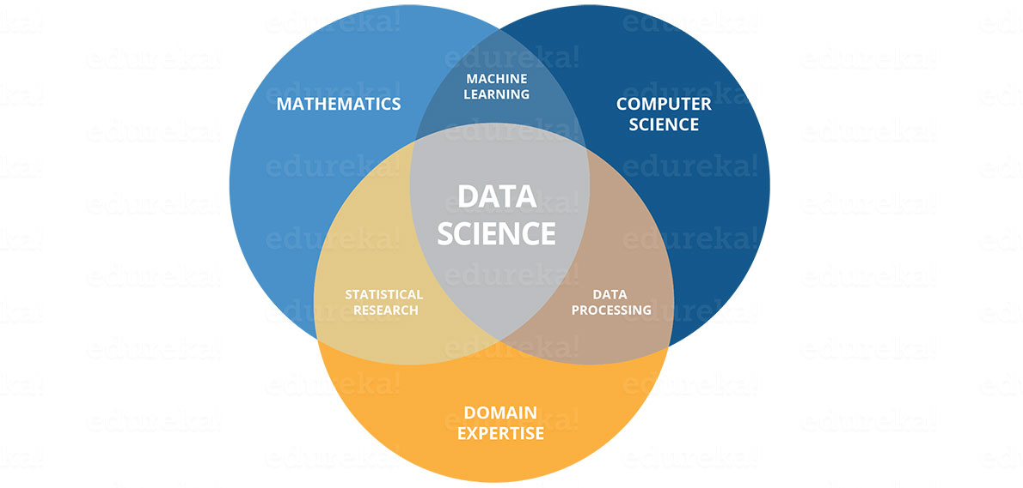
Data Science

Slide 7
Business intelligence
Business Intelligence (BI) is the process of analyzing and reporting historical data.
Moreover, Business Intelligence is entirely a subset of Data Science.Thus, when one is dealing with descriptive statistics, reporting or visualization of past events, she is doing both BI and data science.
Does it involve predictive analtyics ?

Slide 8
Machine Learning
Machine learning (ML) is the ability of machines to predict outcomes without being explicitly programmed to do so.
ML is an approach to AI, however, the two are often confused as ML is actually the only viable path to AI that we, as humans, have developed so far.
Therefore, when we are talking about real-life applications of AI that companies are using, we are actually referring to ML.

Slide 9
Confusing terminologies
Artificial Intelligence
Business Intelligence
Data Science
Data Analytics
Business Analytics
Data Mining (What is it ?)

Slide 10
Bibliography
https://www.kdnuggets.com/2018/05/data-science-machine-learning-business-analytics.html
https://www.kdnuggets.com/2018/07/devops-data-scientists-taming-unicorn.html

